Slide 1
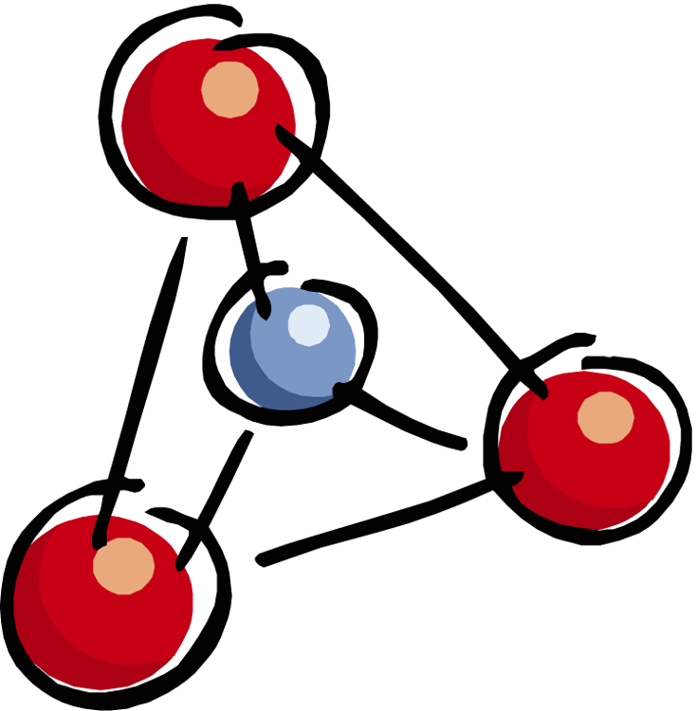
Experimental
Process
Variables and Control Groups

Slide 2
Identifying Variables and Experimental Groups

Slide 3
A lack of sleep can make you gain weight.
Independent variable?
Dependent variable?
Notes:
IV: amount of sleep DV: weight

Slide 4
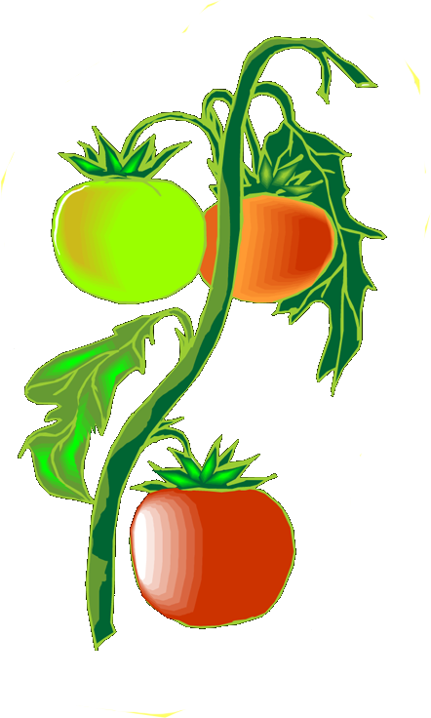
Tomato plants grown with music have more tomatoes.
Independent variable?
Dependent variable?
Notes:
IV: Addition of Music DV: # of tomatoes

Slide 5
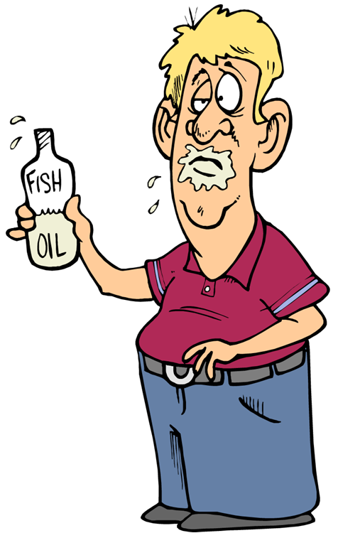
Fish oil in your diet will improve your memory.
Independent variable?
Dependent variable?
Notes:
IV: Fish oil in diet DV: memory

Slide 6
Trout raised in cold water weigh more than trout raised in warm water.
Independent variable?
Dependent variable?
Notes:
IV: temp of water DV: weight of trout

Slide 7
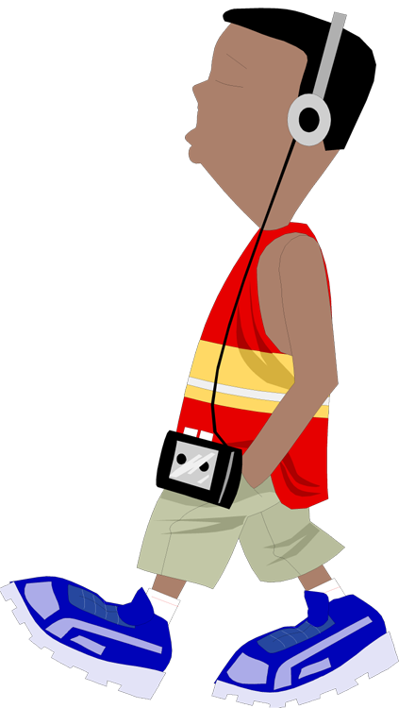
Walking 10,000 steps a day will lower blood pressure.
Independent variable?
Dependent variable?
Experimental group?
One possible control group?
Notes:
IV: people walking 10,000 steps per day DV: blood pressure measurement EG: people walking 10,000 steps CG: people who do not regularly walk 10000 steps a day

Slide 8
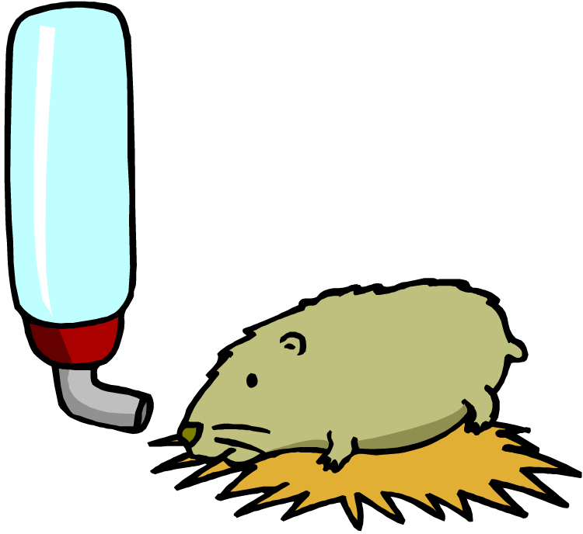
Hamsters raised on a taco diet have less heart disease than hamsters raised on Purina Hamster Chow.
Independent variable?
Dependent variable?
Experimental group?
Control group?
Notes:
IV: taco diet/hamster chow DV: incidence of heart disease EG: hamsters on taco diet CG: hamsters on kamster chow

Slide 9
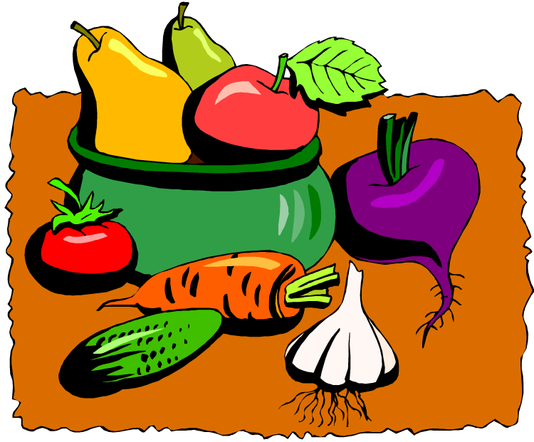
Eating lots of fruits and vegetables will make you a faster runner.
Independent variable?
Dependent variable?
Experimental group?
One possible control group?
Notes:
IV: amt of fruits and vegetables in diet DV: running speed EG: people eating the increased fruits and vegetables CG: people who don’t eat many fruits and vegetables; people who eat a “normal” amount of fruits and vegetables

Slide 10
Exercise cuts the risk of catching colds.
Independent variable?
Dependent variable?
Experimental group?
One possible control group?
Notes:
IV: exercise DV: # of colds caught EG: healthy people who begin exercising CG: otherwise healthy people who don’t exercise

Slide 11
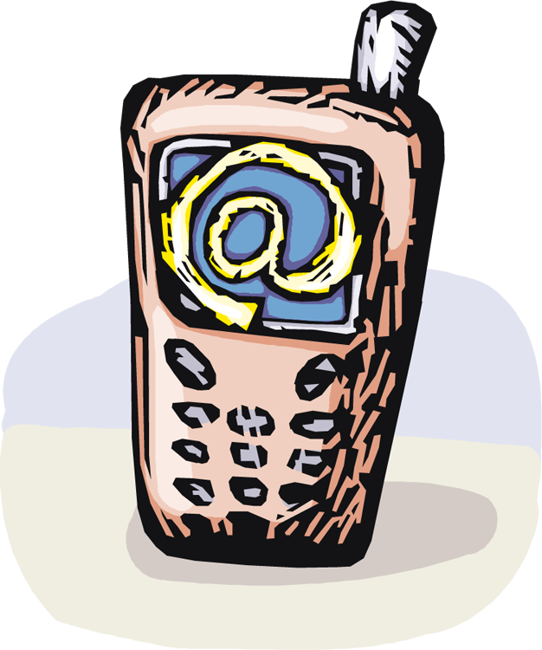
People who have used cell phones for at least 10 years have a greater chance of developing a rare brain tumor.
Independent variable?
Dependent variable?
Experimental group?
One possible control group?
Notes:
IV: cell phone use DV: development of rare brain tumor EG: people who regularly use cell phones for 10+ years CG: people who don’t use cell phones regularly or havent used them for 10 years

Slide 12
More Great Science from The Science Vault
If you enjoyed this powerpoint, you might like these other best-selling products:
Chemical Bonding Go Fish: making chemical bonding less abstract and more fun; several different games allow for differentiation for all ability levels, grades 8 – 12
Scientific Method/Experimental Design Unit: a full-fledged unit with powerpoints, worksheets, and quizzes – great to start off the year, or review throughout the year
Task Cards – great for enrichment, differentiation, or to spur academic discourse in small groups
Continental Drift and Plate Tectonics Powerpoint – 50 interactive slides that introduce continental drift and plate tectonics. Includes links to websites for flash animations
The Life Cycle of Stars Powerpoint – gorgeous photos and videos bring this powerpoint alive for your students
© Jan Parker, The Science Vault, 2009 – for purchaser’s classroom use only. Please do not distribute. For more great science and class management materials, follow me at http://www.thesciencevault.net or on twitter @thesciencevault or head on over to my TpT store: http://www.teacherspayteachers.com/Store/The-Science-Vault

